Slide 1
3D LED array
林萬荃

Slide 2
Gantt Chart
One day (Pending)
Tutorial -> Solder -> Done

Slide 3
Bill of Material
name | quantity | price each | total
3mm LED rating: 20mA , 2V-2.2V | 64 | 2 | 128
ESP32 devkit v1 | 1 | 200~250 | 200~250
PCB | 1 | 50 | 50
74HC595 8-bit shift register | 3 | 10 | 30
160Ω through hole resistor | 16 | 2 | 32
DC power jact | 1 | 5 | 5
2n2222 BJT | 4 | 10 | 40
 |  |  | about 500 $

Slide 4
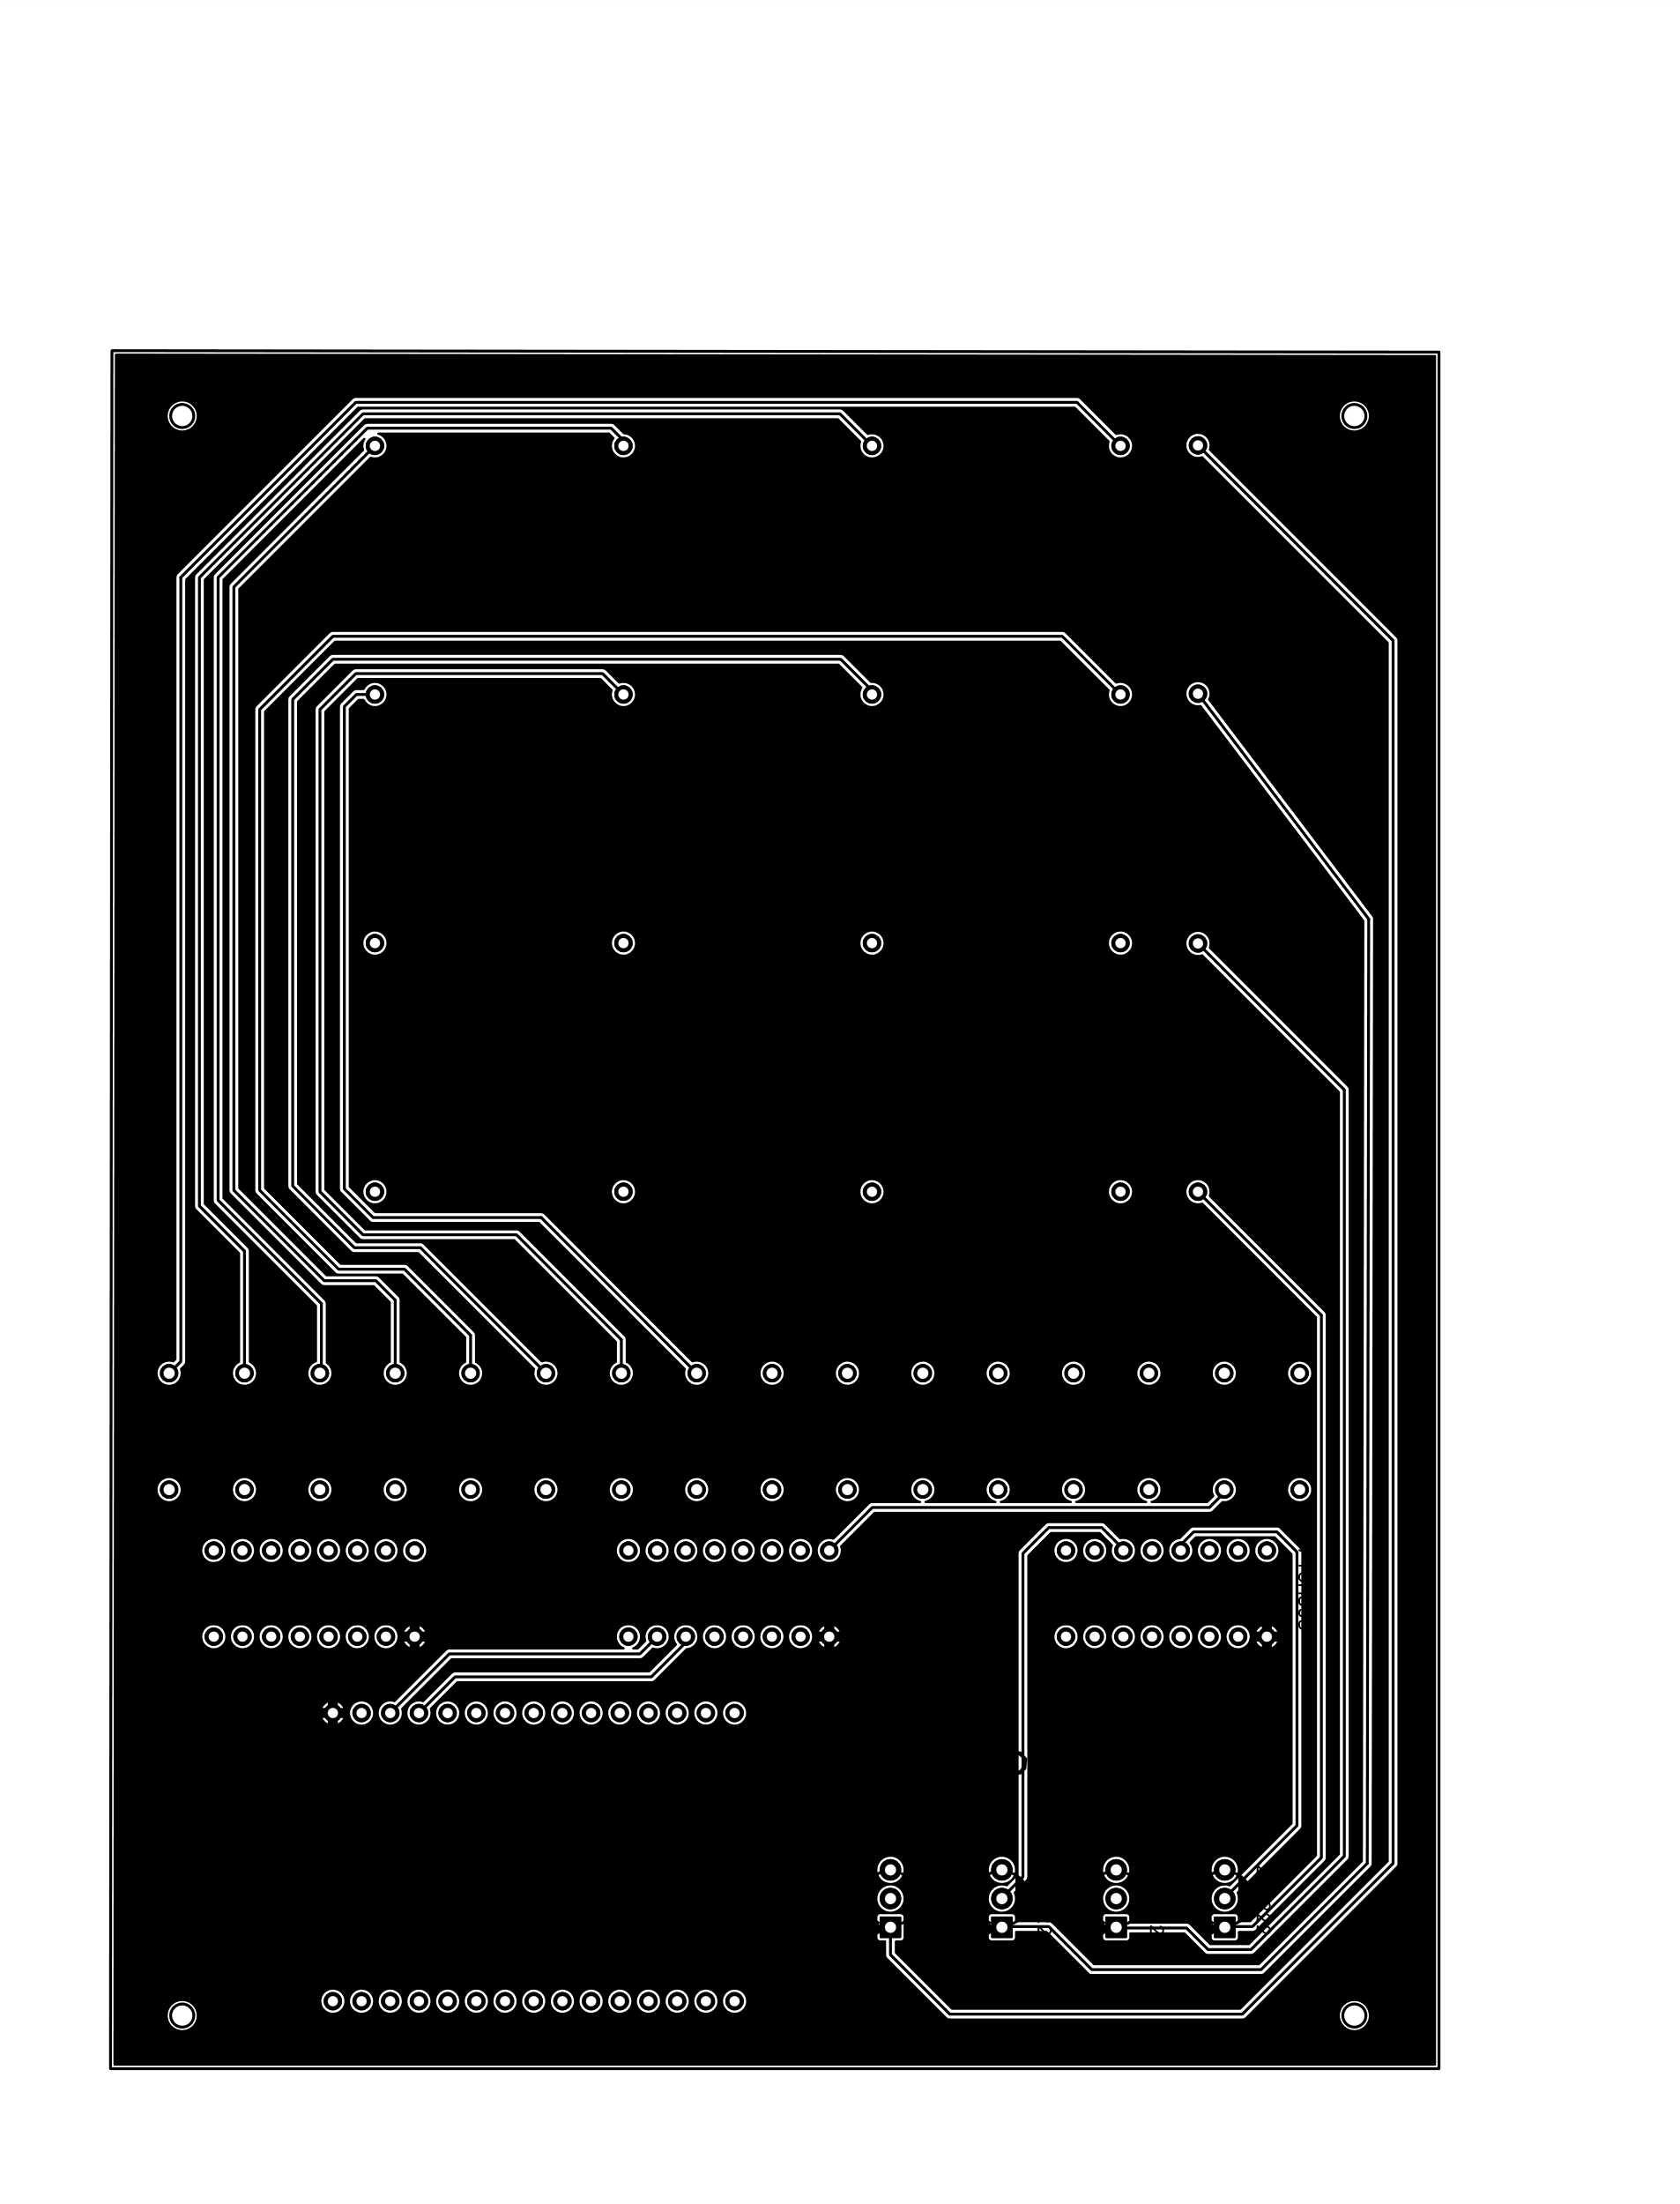
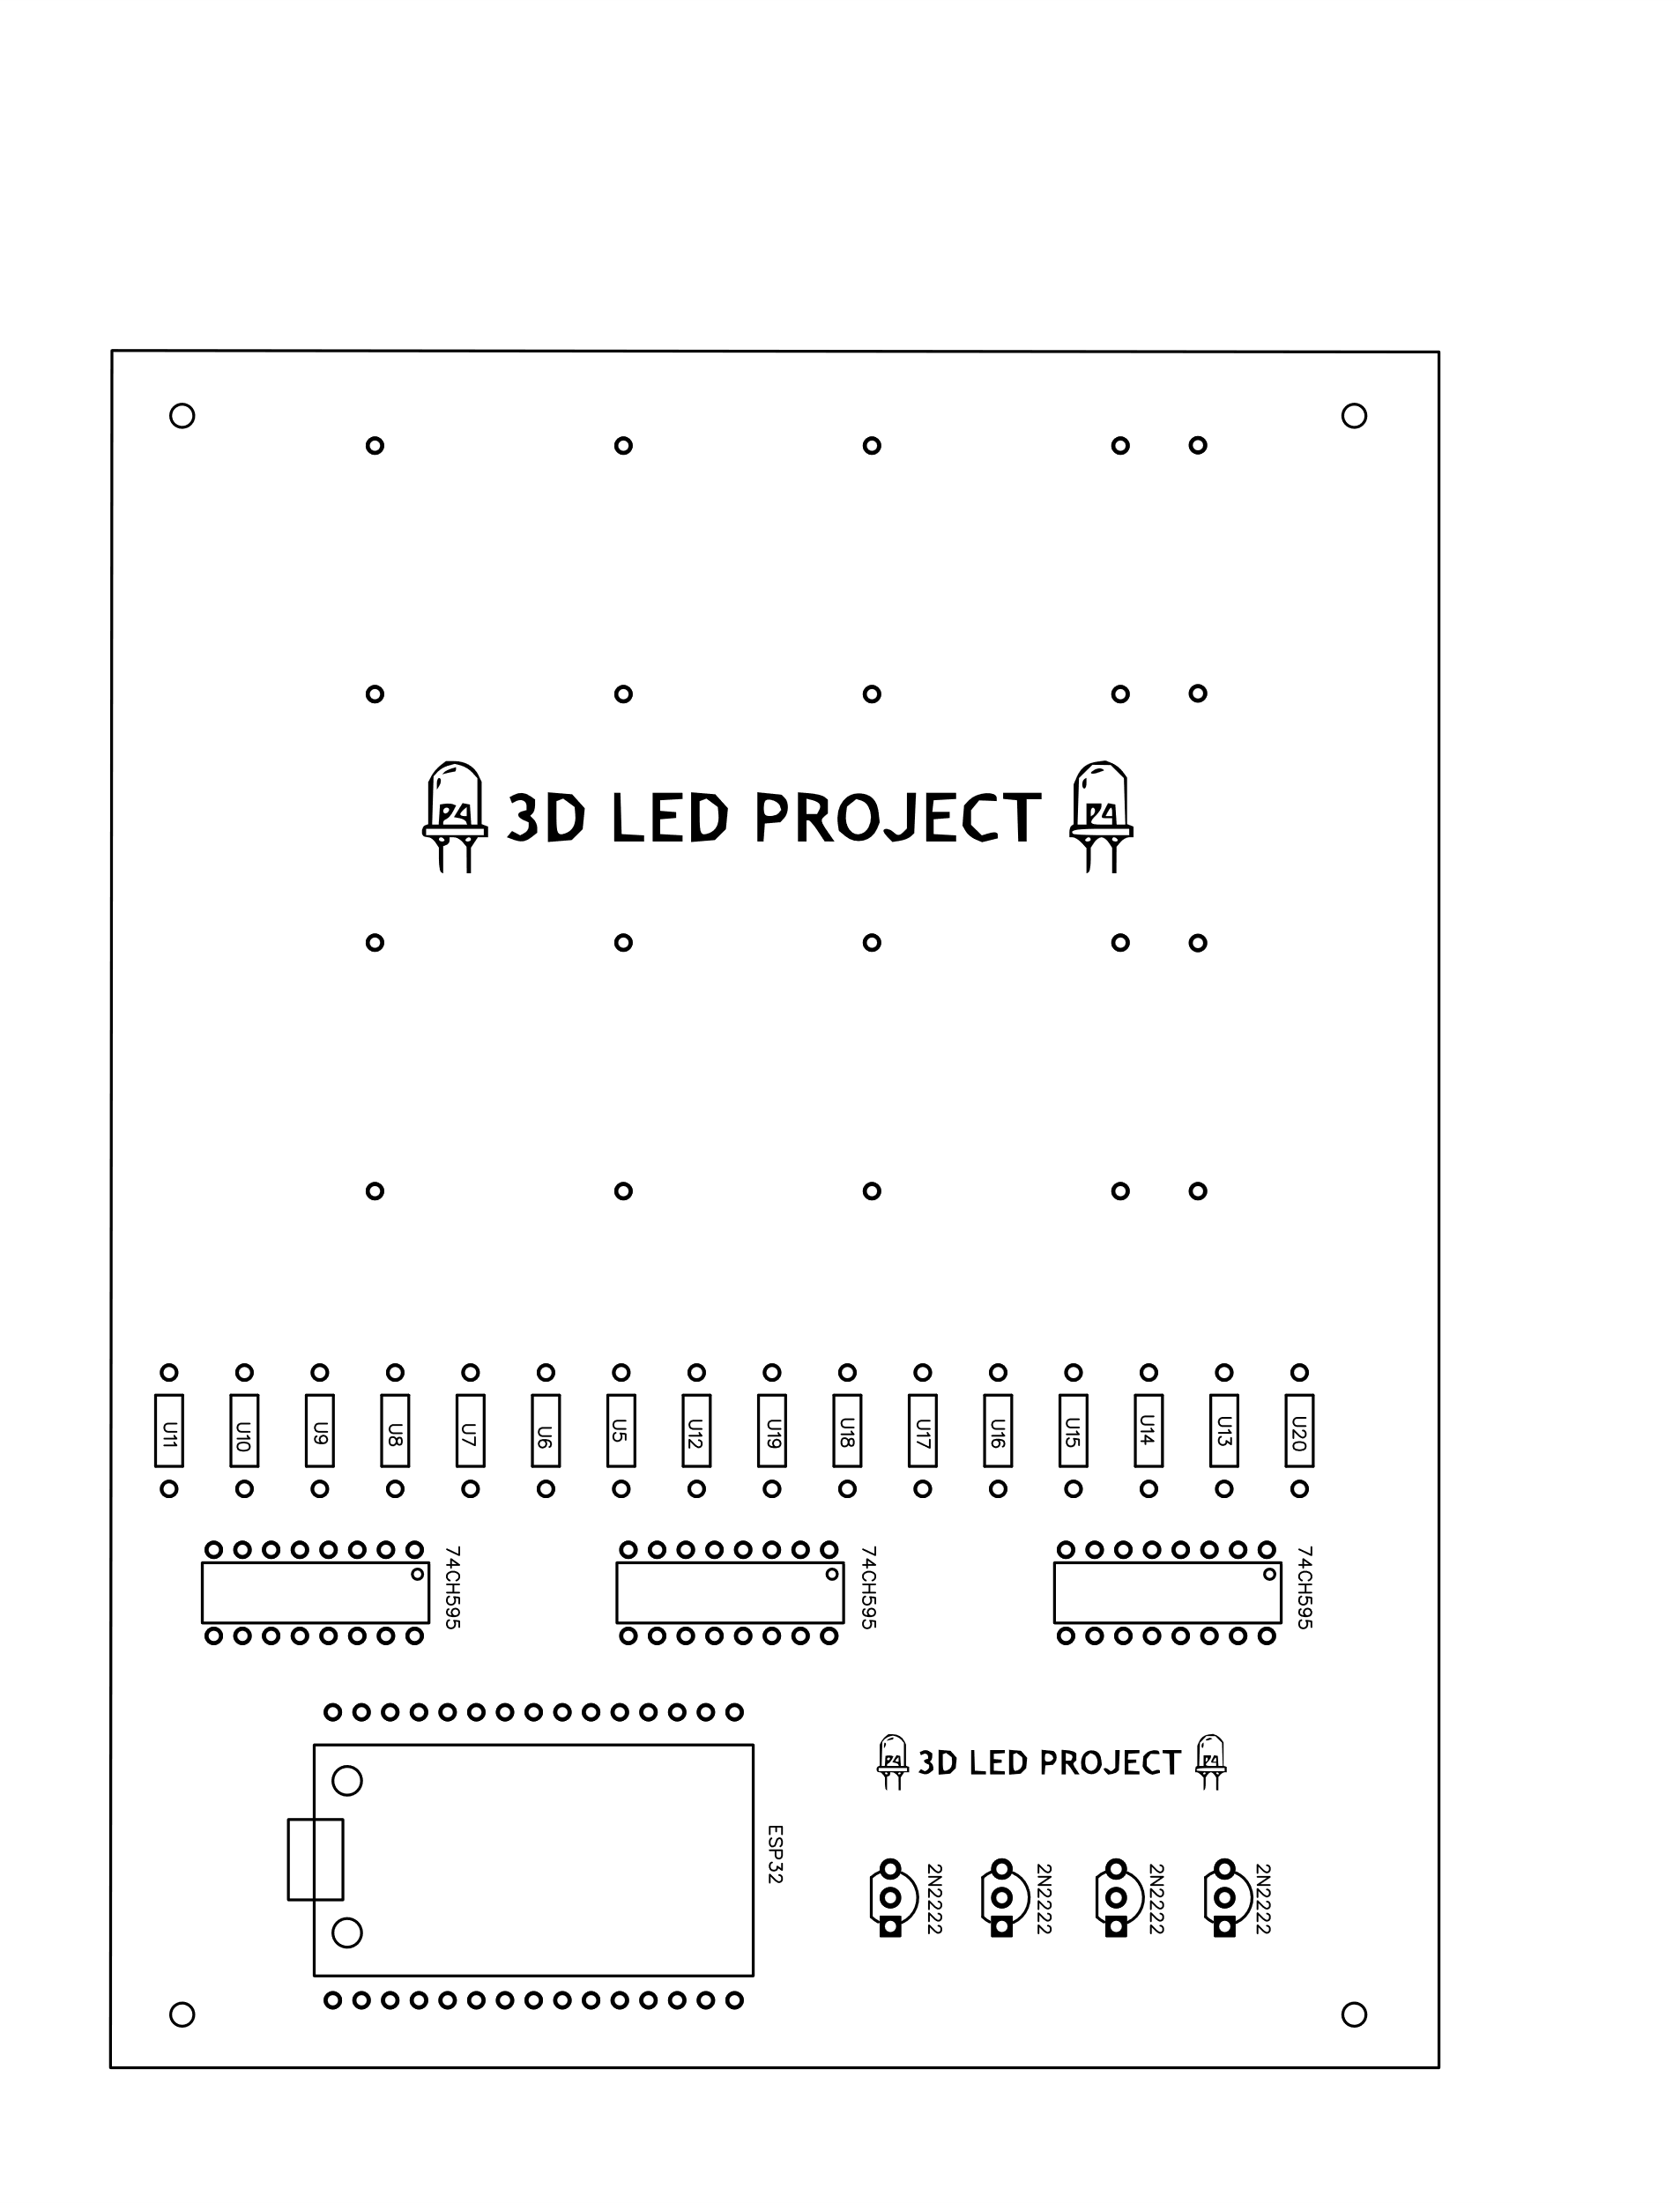
PCB

Slide 5
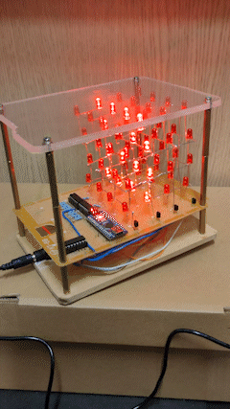
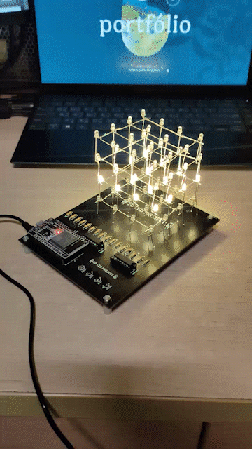
Prototype
Result

